Slide 1
20XC15 -Problem Solving and C Programming
Preprocessor Directives

Slide 2
Outline
Introduction
The #include Preprocessor Directive
The #define Preprocessor Directive: Symbolic Constants
The #define Preprocessor Directive: Macros
Conditional Compilation
The #error and #pragma Preprocessor Directives
The # and ## Operators Line Numbers

Slide 3
Introduction
Six Phases
  Edit
  Preprocess
  Compile
  Link
  Load
  Execute
A separate compilation step before the compiler parses your program
Simple text substitution

Slide 4
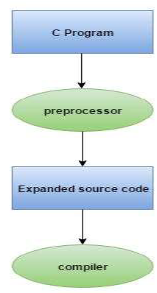
Preprocessor
A preprocessor is a program that processes our
source program before it is passed to the compiler
The preprocessor works on the source code and
creates “expanded source code”
The preprocessor offers several features called
preprocessor directives
Each of theses preprocessor directives begin
with a # symbol
The directives can be placed anywhere in a program
but most often placed at the beginning of the program,
before the function definition
Note : Preprocessor directives are executed before compilation

Slide 5
Introduction
The C preprocessor executes before a program is compiled.
Actions performed by the preprocessor are
  inclusion of other files in the file being compiled
  definition of symbolic constants and macros
  conditional compilation of program code
  conditional execution of preprocessor directives
Preprocessor directives begin with # and only white-space characters and comments may appear before a preprocessor directive on a line

Slide 6
Rules in writing preprocessor directives
Certain rules while writing preprocessor statements
  All preprocessor directives must be started with # symbol
  Every preprocessor statement may be started from the first column (Optional)
  There shouldn’t be any space between # and directive
  A preprocessor statement must not be terminated with a semicolon
  Multiple preprocessor statements must not be written in a single line
  Preprocessor statements can be written any where within the block, function or outside any function

Slide 7
Preprocessor Directives
Various preprocessor directives
  File Inclusion(#include)
  Macro Expansion (#define)
    Simple Macro
    Nested Macro
    Macros with Arguments
  Conditional Compilation(#ifdef -#endif)
  Miscellaneous Directives

Slide 8
File Inclusion (#include)
The #include directive causes a copy of a specified file to be included in place of the directive.
Used to include one file into another file or it simply causes the entire content of one file to be inserted into the source code of another file
File inclusion is used for the following reasons
  if we have a very large program, the code is best divided into several different files, each containing a set of related functions. These files are then included at the beginning of main program file
  There are some commonly needed functions & macro definitions that can be stored in a file and that file can be included in every program we write which would add all the statements in this file to our program as if we have typed in

Slide 9
File Inclusion (#include)
The two forms of the #include directive are
    #include <filename>
    #include “filename”
The difference between these is the location the preprocessor begins searches for the file to be included
  #include <filename> - it searches for a file named in a standard list of system directories
  #include “filename” - preprocessor starts searching in the same directory as the file being compiled for the file to be included (and may search other locations, too) – ie., it searches for a file in a standard list of system directories
    This method is normally used to include programmer-defined headers

Slide 10
Macro Substitution
A macro is a symbol that is recognized by the preprocessor and replaced by the macro body
Macro substitution is a process where an identifier in a program is replaced by predefined string composed of one or more tokens
Syntax : #define identifier replacement-text
The #define directive creates
  Symbolic constants - constants represented as symbols
  Macros - operations defined as symbols
Forms of macro substitution
  Simple macro substitution
  Nested macro substitution
  Argumented macro substitution

Slide 11
Macros
While defining a macro, name of macro is written in capitals to identify that it is a macro and the replacement text may be a constant, a word, a statement or a part of program.
While defining a macro in multiple lines \ is placed at the end of each line
Macro is not a variable, takes no space; its value can’t be changed by assigning a new value
The scope of macro is from its point of declaration to the end of source file being compiled
A macro definition may use previous macro definition
Macro substitution is only done for tokens but not for strings
A macro can be undefined using #undef

Slide 12
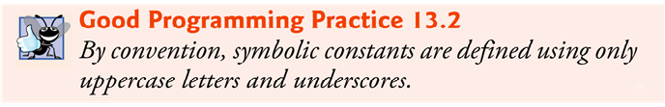
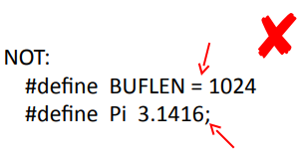
Simple macro Substitution
Simple string replacements is commonly used to defined constants
Examples
  #define COUNT 100
  #define FALSE 0
  #define SUBJECTS 6
  #define PI 3.1415
  #define name “PSG”
  #define LESSTHAN <
  #define PLUS +
  #define SIZE sizeof(int) *4
  #define START main() {
  #define OR ||
  #define A (60-25)

Slide 13
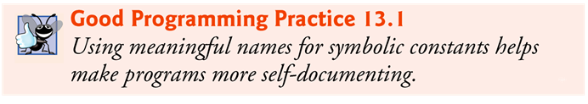
Simple macro Substitution
#define PI 3.14
#include<stdio.h>
int main()
{
int rad;
float area,cir;
printf("Enter the radios:");
scanf("%d",&rad);
printf("Area %f", PI*rad*rad);
printf("\nCircumference %f",2*PI*rad);
return 0;
}
Output:
Enter the radios: 15
Area 706.500000
Circumference 94.200005
While executing the program PI is replaced with 3.14 by preprocessor in the source
code

Slide 14
Simple macro Substitution
The preprocessor performs a literal test substitution, whenever the defined name occurs. Thus, we can use a macro to define almost anything
For example
Is the following program valid??
  START
  INTEGER total =200, avg=20, count=0;
  if ( total EQUALS 200 AND avg EQUALS 60)
  INCREMENT count;
  END
#define START main() {
#define INTEGER int
#define EQUALS ==
#define AND &&
#define INCREMENT ++
#define END }

Slide 15
Simple macro Substitution
If we want to change the value of PI as 3.142857 in place of 3.14 then we don’t need to change the total program rather it is enough to change the macro definition as
#define PI 3.142857
Everything to the right of the symbolic constant name replaces the symbolic constant
For example
#define PI = 3.14159 causes the preprocessor to replace every occurrence of the identifier PI with = 3.14159
This is the cause of many subtle logic and syntax errors
Redefining a symbolic constant with a new value is also an error

Slide 16
Simple macro Substitution
#include<stdio.h>
#define NUM int
#define OUT printf
NUM main()
{
NUM a,b,c;
a=45;
b=25;
c=a+b;
OUT("Sum %d",c);
return 0;
}
prog.c 3: int main()
prog.c 4: {
prog.c 5: int a,b,c;
prog.c 6: a=45;
prog.c 7: b=25;
prog.c 8: c=a+b;
prog.c 9: printf("Sum %d",c);
prog.c 10: return 0;
prog.c 11: }
In the above example NUM, OUT are two macros and having their replacement text. The preprocessor replaces the macro names with their replacement text
The above code is intermediate or expanded source generated by C preprocessor. Here we can find the replacement of macros with their replacement text

Slide 17
Example - 1
    #define PI 3.14
    #include<stdio.h>
    int main()
    {
    int a;
    a=sizeof(PI);
    printf("%d",a);
    return 0;
    }
Output: 8
Example explained:
a=sizeof(PI); is
a=sizeof(3.14);
As the default type of any floating point constant in C language
is double, it returned 8

Slide 18
Example - 2
Note: The scope of macro is from its point of declaration to the end of source file being compiled
    #include<stdio.h>
    int main()
    {
    printf("%d",A);
    #define A 10
    printf("\n%d",A);
    return 0;
    }
Error: Undefined symbol ‘A’ in function main()
Example explained:
Macro A is defined in the 5th line of the program,
can’t be accessed to the portion before to its definition

Slide 19
Example - 3
#include<stdio.h>
void display();
int main()
{
if(40<20)
{
#define A 10
}
display();
printf("\n%d",A);
return 0;
}
void display()
{
printf("%d",A);
}
Output:
10
10
Here macro A is defined in the if block which gives false but, replaced
properly from its point of definition to the end of source file because
macro substitution happens before execution of program

Slide 20
Example 4
Macro is not a variable, takes no space; its value can’t be changed by assigning a new value
#define PI 3.1415
        int main()
        {
        printf("Value of PI %f", PI);
        PI=3.1435;
        printf("\nValue of PI %f", PI);
        return 0;
        }
Error: Lvalue required in function main

Slide 21
Example - 5
Macro substitution is only done for tokens but not for strings
Example:
#define YES 1
int main()
{
int a=YES;
printf("%d",a);
printf("\nYES",a);
return 0;
}
Output:
1
YES
Example explained:
Here macro YES is replaced every where but, not with in the string

Slide 22
Example - 6
A macro can be undefined using #undef
Example:
#include<stdio.h>
int main()
{
#define A 10
printf("\n%d",A);
#undef A
printf("\n%d",A);
return 0;
}
Output:
Error: Undefined symbol ‘A’ in function main()
int main()
{
#define A 10
printf("\n%d",A);
#undef A
#define A 20
printf("\n%d",A);
return 0;
}

Slide 23
Example - 7
A variable can’t be declared with a name of macro within the scope of macro. Macro replaces the variable with the replacement text because macro substitution happens before compilation of program
Example:
#include<stdio.h>
#define a 10
int main()
{
int a=40;
printf("%d",a);
return 0;
}
Output:
Error
Example explained:
By looking at the Expanded source, we come to know that variable name is replaced with its replacement text.
Compiler doesn’t accept to declare variable with a number

Slide 24
Nested Macro
A macro definition may use previous definition
#define OUT printf
#define PRINT OUT("Hello World")
int main()
{
PRINT;
return 0;
}
Output:
Hello World
Here Macro OUT is used in the macro definition PRINT, finally the replacement text of
PRINT;
OUT("Hello World")
printf ("Hello World")

Slide 25
Nested Macro
#define PRINT OUT("Hello World")
#define OUT printf
int main()
{
PRINT;
return 0;
}
Output:
Error
Example explained:
Here the scope of OUT would be from the 2nd line to the total source but, can’t be accessed to the previous lines

Slide 26
Nested Macro
#include <stdio.h>
#define SQUARE(x) (x*x)
#define CUBE(x) (SQUARE(x)*x)
int main()
{
int no;
printf("Enter the number=");
scanf("%d",&no);
printf("\nThe square of %d is= %d",no, SQUARE(no));
printf("\nThe cube of %d is= %d",no, CUBE(no));
}
If no=4, CUBE(no) resulting in the following expansion
(SQUARE(4) * 4)
(4* 4* 4)

Slide 27
#define Preprocessor Directive: Macros
A macro is an identifier defined in a #define preprocessor directive
As with symbolic constants, the macro-identifier is replaced in the program with the replacement-text before the program is compiled
Macros may be defined with or without arguments
A macro without arguments is processed like a symbolic constant
In a macro with arguments, the arguments are substituted in the replacement text, then the macro is expanded—i.e., the replacement-text replaces the identifier and argument list in the program

Slide 28
Macros with Arguments
Consider the following macro definition with one argument for the area of a circle:
    #define PI 3.14
    #define CIRCLE_AREA( x ) ( ( PI ) * ( x ) * ( x ) )
Wherever CIRCLE_AREA(y) appears in the file, the value of y is substituted for x in the replacement-text, the symbolic constant PI is replaced by its value (defined previously) and the macro is expanded in the program.
For example, the statement area = CIRCLE_AREA( 4 );
is expanded to area = ( ( 3.14 ) * ( 4 ) * ( 4 ) );
and the value of the expression is evaluated and assigned to
variable area.
The parentheses around each x in the replacement text force the proper order of evaluation when the macro argument is an expression

Slide 29
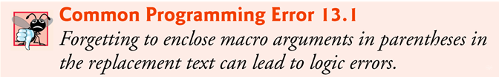
Macros with Arguments
For example, the statement
    area = CIRCLE_AREA( c + 2 );
is expanded to
    area = (( 3.14 ) * ( c + 2 ) * ( c + 2 ));
which evaluates correctly because the parentheses force the proper
order of evaluation
If the parentheses are omitted, the macro expansion is
    area = 3.14 * c + 2 * c + 2;
which evaluates incorrectly as
    area = ( 3.14 * c ) + ( 2 * c ) + 2;
because of the rules of operator precedence

Slide 30
Macros with Arguments
Macro CIRCLE_AREA could be defined as a function.
        double circleArea( double x )
        {
        return 3.14 * x * x;
        }
Performs the same calculation as macro CIRCLE_AREA, but the overhead of a function call is associated with function circleArea
The advantages of macro CIRCLE_AREA - macros insert code directly in the program—avoiding function call overhead—and the program remains readable because the CIRCLE_AREA calculation is defined separately and named meaningfully

Slide 31
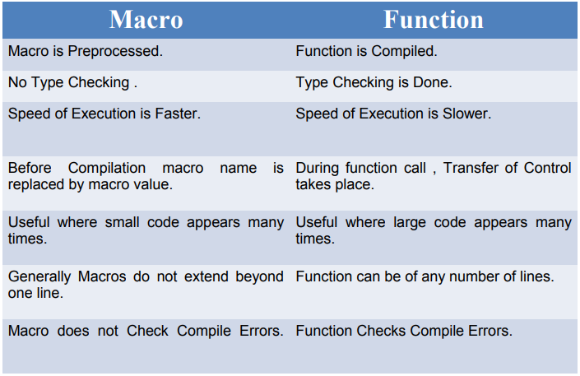
Macros Vs Functions

Slide 32
Macros with Arguments
The following is a macro definition with two arguments for the area of a rectangle:
    #define RECTANGLE_AREA( x, y ) ( ( x ) * ( y ) )
Wherever RECTANGLE_AREA(x, y) appears in the program, the values of x and y are substituted in the macro replacement text and the macro is expanded in place of the macro name.
For example, the statement
    rectArea = RECTANGLE_AREA( a + 4, b + 7 );
is expanded to
    rectArea = ( ( a + 4 ) * ( b + 7 ) );

Slide 33
Example
#include<stdio.h>
#define MAX(x,y) x>y?x:y
#define MIN(x,y) x<y?x:y
int main()
{
int a, b, big, small;
printf("Enter two numbers:\n");
scanf("%d%d",&a,&b);
if(a==b)
printf("Equal");
else
{
big=MAX(a,b); // big =a>b ? a : b;
small=MIN(a,b); // small = a<b ? a : b;
printf("Biggest number %d",big);
printf("\nSmallest number %d",small);
}
return 0;
}
Execution:
Enter two numbers:
45
45
Equal
Enter two numbers:
45
12
Biggest number 45
Smallest number 12

Slide 34
Conditional Compilation
Conditional compilation enables you to control the execution of preprocessor directives and the compilation of program code
Each of the conditional preprocessor directives evaluates a constant integer expression
Cast expressions, sizeof expressions and enumeration constants cannot be evaluated in preprocessor directives
The conditional preprocessor construct is much like the if selection statement
Conditional Compilation Directives are
  #if
  #else
  #endif
  #ifdef
  #ifndef
  #pragma
  #undef

Slide 35
Conditional Compilation
Every #if construct ends with #endif
Directives #ifdef and #ifndef are shorthand for #if defined(name) and #if !defined(name) respectively
A multiple-part conditional preprocessor construct may be tested by using the #elif (the equivalent of else if in an if statement) and the #else (the equivalent of else in an if statement) directives
These directives are frequently used to prevent header files from being included multiple times in the same source file
We use this technique extensively in the C++ programs

Slide 36
Conditional Compilation
Consider the following preprocessor code
        #if !defined(MY_CONSTANT)
        #define MY_CONSTANT 0
        #endif
These directives determine if MY_CONSTANT is defined
The expression defined( MY_CONSTANT) evaluates to 1 if MY_CONSTANT is defined; 0 otherwise
If the result is 0, !defined(MY_CONSTANT) evaluates to 1 and MY_CONSTANT is defined
Otherwise, the #define directive is skipped

Slide 37
Conditional Compilation
During program development, it is often helpful to “comment out” portions of code to prevent it from being compiled.
If the code contains comments, /* and */ cannot be used to accomplish this task.
Instead, you can use the following preprocessor construct:
        #if 0
        code prevented from compiling
        #endif
To enable the code to be compiled, replace the 0 in the preceding construct with 1.

Slide 38
Conditional Compilation
#ifndef
#include <stdio.h>
#define A 100
int main()
{
#ifndef B{
printf("B is not defined");
#define B 300
}
#else
printf("B is already defined”);
#endif
return 0;
}
#ifdef
#include <stdio.h>
#define VALUE 100
int main()
{
#ifdef VALUE
printf("VALUE is defined\n");
#else
printf("VALUE is not defined\n");
#endif
return 0;
}

Slide 39
#error Preprocessor Directives
The #error directive causes the preprocess to print a diagnostic error message, using the argument as a part of the message
Useful to trap incorrect conditions in conditional compilation
Compilation is aborted when this directive is invoked
Example
#ifndef __MATH_H
#error First include then compile
#else
int main()
{
float a,b=25;
a=sqrt(b);
printf(“%f”,a);
}
#endif
Result: First include then compile

Slide 40
#pragma Preprocessor Directives
#pragma directive is used to control the actions of the compiler in a particular portion of a program without affecting the program
pragma directive varies from one compiler to another compiler
If compiler does not recognize particular pragma then it ignore the pragma statement without showing any error or warning message
We can avoid the structure padding using #pragma
The default compiler alignment is of 4 bytes. we can use #pragma to change the byte alignment to 1 byte

Slide 41
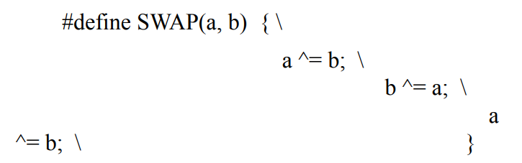
Preprocessor Operators- Macro Continuation (\)
The macro continuation operator is used to continue a macro that is too long for a single line.' \ ' indicate line continuation
The slash tells the preprocessor that the macro continuous to the next line
Example

Slide 42
Preprocessor Operators- The Stringize (#) Operator
The stringize or number-sign operator ('#'), when used within a macro definition, converts a macro parameter into a string constant
This operator may be used only in a macro having a specified argument or parameter list
For example
# define say(m) printf(#m)
int main()
{
say(Hello);
}
Output
Hello
  #define HELLO( x ) printf (“ Hello, “ #x “\n”);
  HELLO(John)
  becomes
  printf (“ Hello, John\n”);

Slide 43
Preprocessor Operators- The Token Pasting (##) Operator
The token-pasting operator (##) within a macro definition combines two arguments
It permits two separate tokens in the macro definition to be joined into a single token
For example
#include <stdio.h>
#define paster( n ) printf_s( "token" #n " = %d", token##n )
int token9 = 9;
int main()
{
paster(9);
}
Output
token9 = 9
Output
2050
#include<stdio.h>
#define STR_CONCAT(x, y) x##y
main() {
printf("%d", STR_CONCAT(20, 50)); }

